Slide 1
EY Techathon 4.0
Re-imagining possibilities with Generative AI
Detailed Submission

Slide 2



Team Details
P
Team Name: Data Ninjas
Problem Statement : Rani, a student from a village in Kerala, is struggling to get back to her education following
the delay caused by the pandemic. While the government announced online classes, language remained a huge constraint. As eager Rani is to resume her studies, infrastructure and accessibility issues are becoming impediments for her.
Team Member 1 Name : N Yogeesh
College name : Indian Institute of Foreign Trade, New Delhi
Contact Detail : 9535846680
Role in Solution Development : Architechture and Wireframes
Team Member 2 Name : Chinmay Pandya
College name : Indian Institute of Foreign Trade, New Delhi
Contact Detail : 7710061699
Role in Solution Development : UI/UX Design and Wireframes
Team Member 3 Name : Sakshi Patil
College name : Indian Institute of Foreign Trade, New Delhi
Contact Detail : 9890832479
Role in Solution Development : Flowcharts and Wireframes

Slide 3




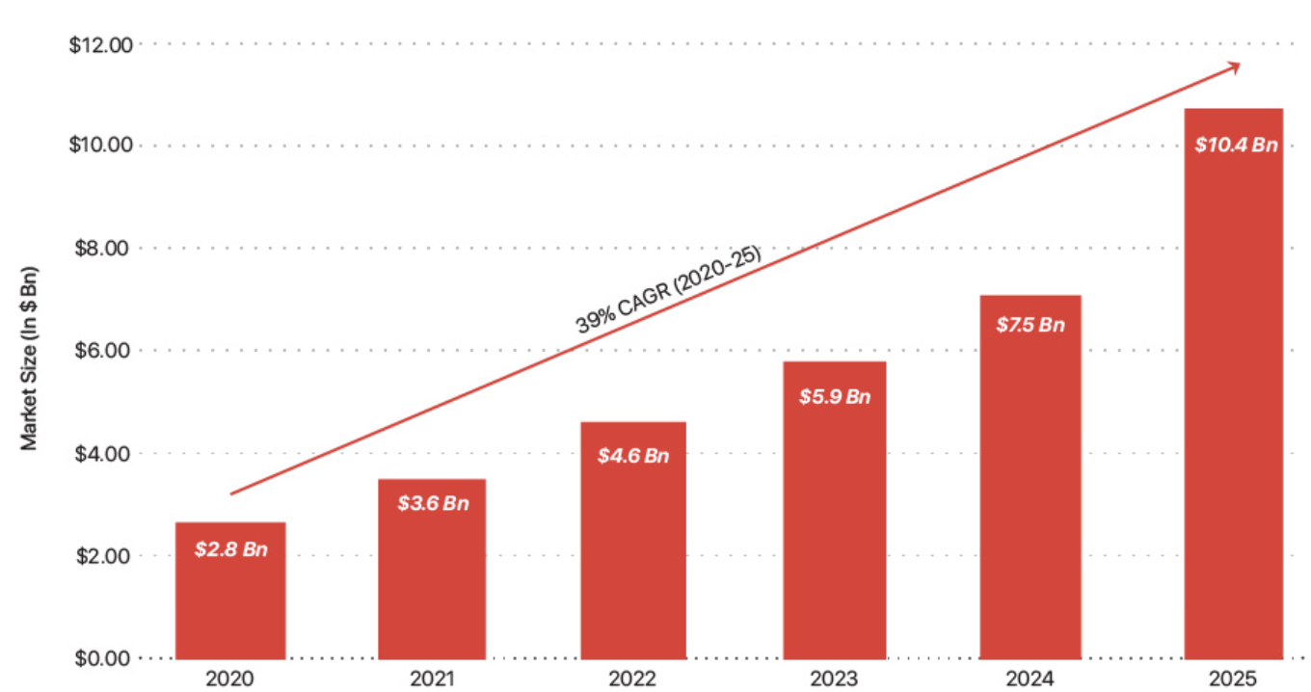



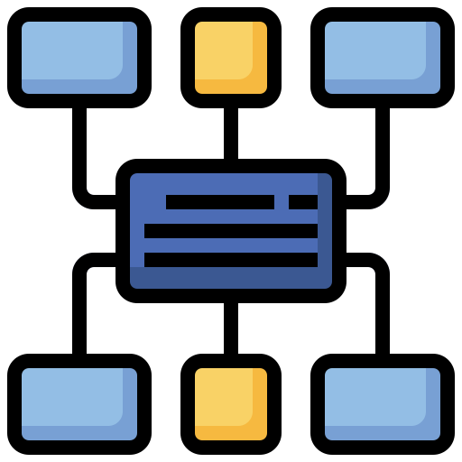


Executive Summary
Competitive Environment and Industry Overview
Solution and Methodology Used
Some important factors to consider -
Working on the recommended solutions as provided in the earlier deck some major solutions of the pain points identified were - AI Based Language Translation, grading system, user-friendly, low bandwidth EdTech solution.
There are over 3,500 EdTech Start-ups in India.
The Indian EdTech market is expected to reach a value of $10.4 billion by 2025.
The Indian EdTech industry has raised over $700 million in funding till date.
The Indian EdTech industry is expected to create 10 million jobs by 2025.
Solutions have been implemented via incorporating Generative AI in the backend of an EdTech based application which greatly enhances the user experience and the utility of an app while still addressing the pain points like language and infrastructural problems as discussed in the problem statement.
Introducing EdNinja
The app will focus on addressing the barriers as discussed earlier. The The salient features are-
Understanding of the App
Addressing language barriers with effective use of language preferences and real time translations by using generative AI in the backend to keep up with the video and fulfill its tasks effectively and efficiently.
Analyzing customer responses and using a recommendation engine in the background to keep updated with the consumer choices and then using the My Feed page to reflect those changes
Front End
The UI sends its data to the API which the API collects
API in the middle acts as a communication layer between the two basic ends of the app
The Indian EdTech industry is still in its early stages of development, but it is already having a significant impact on the Indian education system.
EdTech is helping to improve access to quality education, make learning more engaging and personalized, and prepare students for the future workforce.
It is also poised for continued growth in the years to come.
Using predictive analytics to understand the needs and situations of each customer which the API communicates from the front end (UI) layer to the Gen AI layer. further enhancing and personalizing the recommendations.
Using NLP and Text analytics in the background to generate Interactive Mind Maps and analogies. This can be extremely helpful to students to develop and retain newer concepts.
Back End
Generative AI Engine with functional capabilities like NLP, Text Analytics, Predictive Analytics etc

Slide 4






Understanding of The Problem
Understanding the problem at hand
Rani, a student residing in a village in Kerala, is facing difficulties in resuming her education due to the disruptions caused by the pandemic. Despite the government's introduction of online classes, language barriers pose a significant challenge for her. While Rani is eager to continue her studies, obstacles related to infrastructure and accessibility are hindering her progress. The primary challenge for students like Rani is the need for innovative applications or solutions integrating AI-powered content generation, automated grading systems, and virtual tutors to provide personalized support. Alternatively, solutions driven by generative AI are sought to enhance information retention and enable students to learn at their own pace. The overarching goal is to overcome these challenges and empower students like Rani to access quality education despite the constraints imposed by the pandemic and regional limitations.
Customer Persona
Target Industry
User Group
Rani is a student of a village in Kerala. She faced major difficulties resuming education post covid. The major issues were-
Accessibility Issues
Infrastructure Issues
Language Barriers
The target is the EdTech (Education Technology) Industry in India.India’s EdTech industry is one of the fastest-growing in the world, and it is expected to reach a value of $10.4 billion by 2025. Reasons being, including the increasing prevalence of smartphones and internet access, the rising demand for quality education, and the government's focus on promoting digital learning.
Reasons for development of the EdTech sector
The gap in quality of education delivered in private school and the public institutions is increasing every year
With the outbreak of Covid-19 in India, though, private and public schools have struggled to facilitate classes with the limited number of online resources available.
Primary objective employability of students and not just degrees is not met by traditional sector
The main user groups that we will be targeting in the early stages would be children like Rani affected by the situation the most.
Hence our user group will fall into category of-
School Students who have been affected by Covid-19
Students requiring remedial classes for finishing up on studies disrupted due to some reason
Students who are facing other infrastructural and language barriers
Users who will most benefit from the integration of generative AI in the field of Education
In addition to this what a student like that needs is access to quality content coupled with features like having hands on access to automatic grading systems, personalized support and virtual tutors.
To a large scale the issues that this type of a consumer faces can be tackled by integrating Generative AI in the field of education and delivering to the needs of this consumer.

Slide 5






Solutions Implementation
Customer Value Proposition
Impact of Proposed Solution
Rationale for Choosing Technology
Personalized Learning Paths: Tailored education journeys based on individual learning patterns and preferences.
Dynamic Visualizations: AI-generated mind maps and analogies for simplified understanding of complex concepts.
Real-Time Assessments: AI-driven evaluations and engaging quizzes for instant feedback and continuous improvement.
Community Collaboration: Connect with a supportive community, fostering collaborative learning through discussions and study groups.
Equal Access to Quality Education: Bridging the urban-rural education gap, providing rural girls with high-quality content and learning resources.
Empowerment Through Personalized Learning: Fostering confidence and ownership by tailoring learning paths, overcoming geographical barriers, and accommodating diverse learning styles
Community Collaboration for Support: Creating a virtual support network, connecting rural girls with peers, and promoting collaborative learning experiences.
AI Engine (TensorFlow/PyTorch): Enables personalized learning paths, content curation, and adaptive assessments, ensuring a tailored educational experience.
Cloud Computing (AWS/Azure/Google Cloud): Provides scalable infrastructure for data storage, processing, and real-time personalization, optimizing costs and accommodating varying workloads.
Mobile App Development (React Native/Flutter): Ensures cross-platform accessibility, reaching a diverse user base and offering a consistent learning experience on both Android and iOS devices.
Database Management (MongoDB/Firebase): Supports efficient data storage and retrieval, crucial for user progress tracking, dynamic content generation, and collaborative learning features.
Web Technologies (React.js/Angular): Provides a responsive and interactive web interface, enhancing the user experience on both desktop and mobile devices.
Implementation and Effectiveness
Scalability of the Solution
Pilot Testing: Before rolling out the EdTech solution to the entire institution or organization, it is important to pilot test it with a small group of users. This will help to identify any problems with the solution and make sure that it is working as expected.
Training: The next step is to train all users on how to use the app. This training should be comprehensive
Evaluation: It is important to evaluate its effectiveness. This can be done by measuring several factors.
Types of Scaling used in the space are – Horizontal, Vertical, and Geographic Scaling.
The solution also will be able to scale to accommodate increasing usage, such as the number of concurrent users, the amount of data being processed
The infrastructure of the EdTech solution will be able to handle increasing traffic and data volumes. This includes using cloud-based services, load balancing, and caching.
The EdTech solution will also have an efficient data management system in place. This includes using data compression, data partitioning, and data replication.

Slide 6
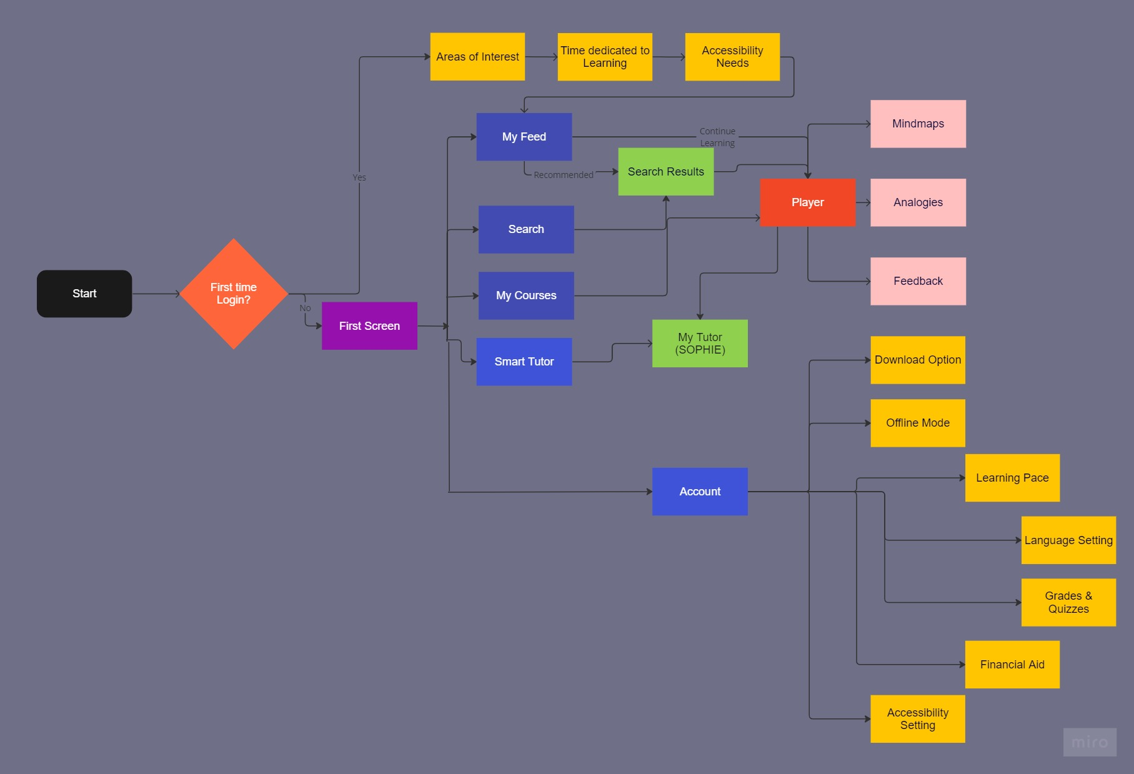
Flowchart
EdNinja
First Screen of App
Second Connecting Screen
Features available below Play screen of an App
Last stage of Settings and new Login
Play Screen of Learning Video

Slide 7

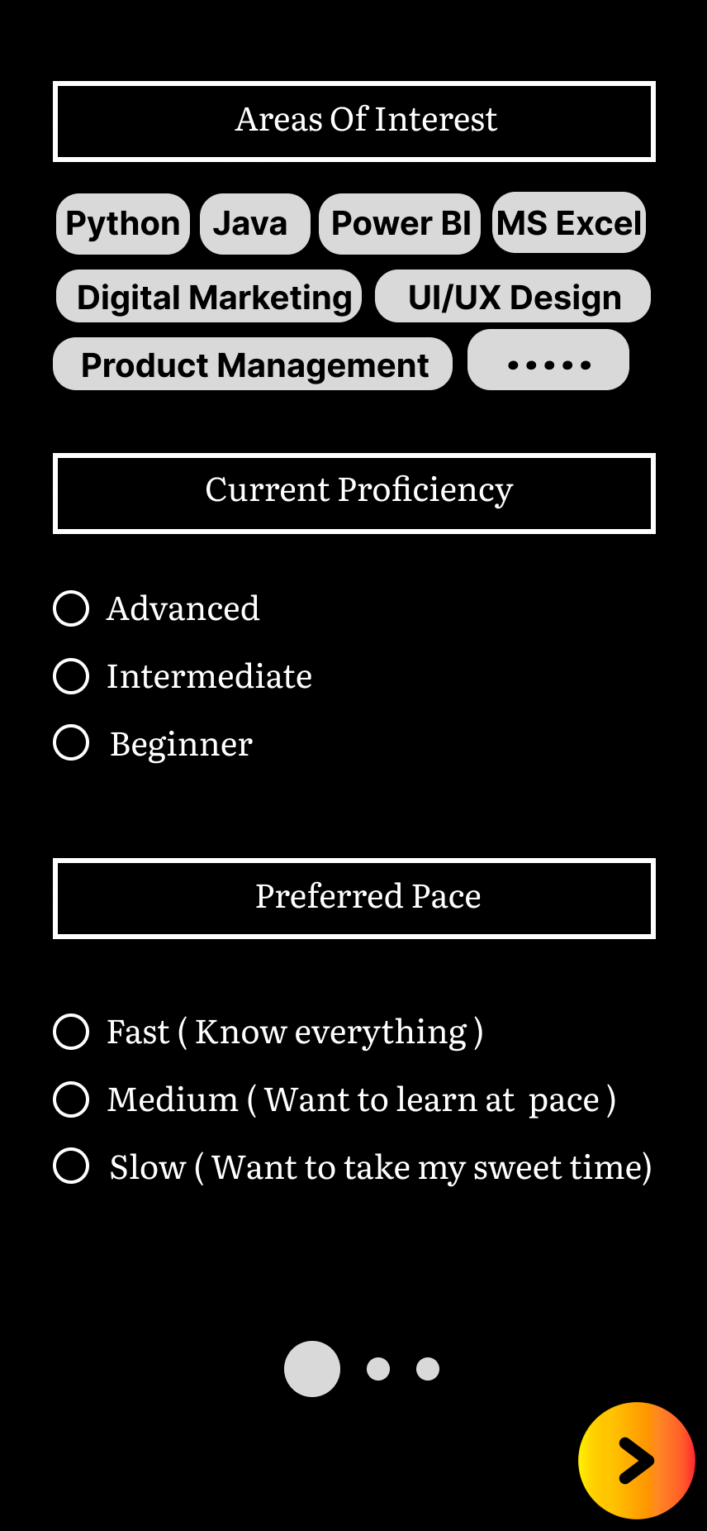
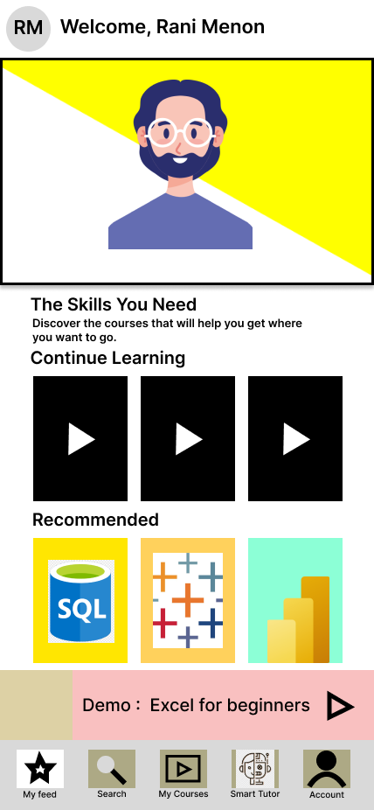
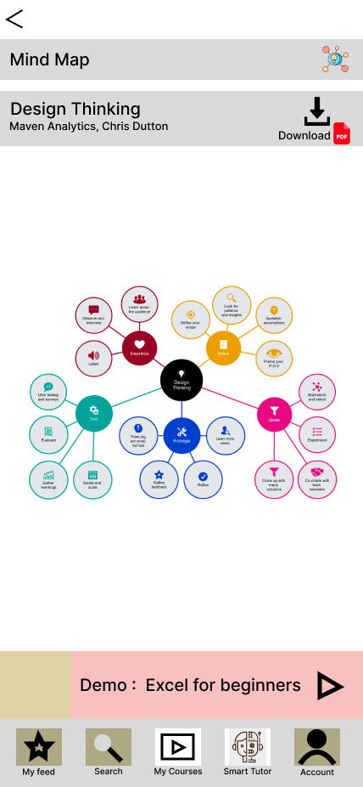
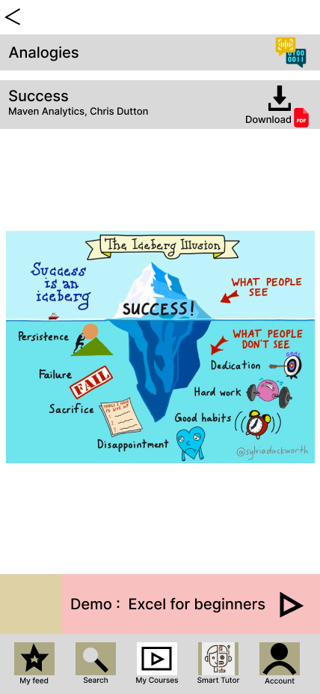
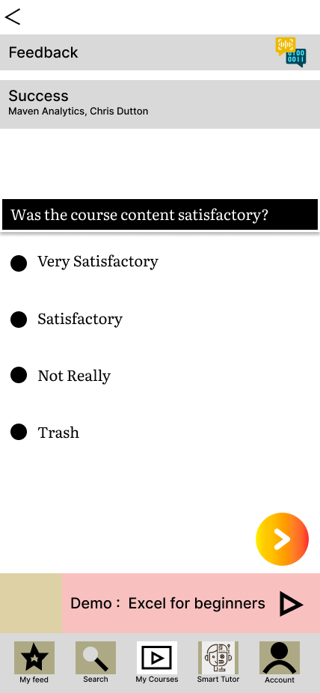
Architectural Diagram
Login Screen
Recommendations
Mind Maps
Analogies
Feedback
Questions asked will collect data related to student’s interests
Using that data API will send it to generative AI for Predictive Analysis to recommend the personalized content
Based on questions asked on login screen and student’s current learnings, generative AI will apply Predictive analytics to recommend related content using Market Basket Analysis Technique
Content player screen will have 3 functions related to content, first is Mind Maps.
For the current learning video, generative AI will generate Mind Maps for easy understanding
Second is Analogies
For the current learning video, generative AI will generate analogies of the concept with real world using NLP technique
Third is Feedback
With the given feedback, generative AI will generate analysis of it and will give recommendations using prescriptive analytics

Slide 8
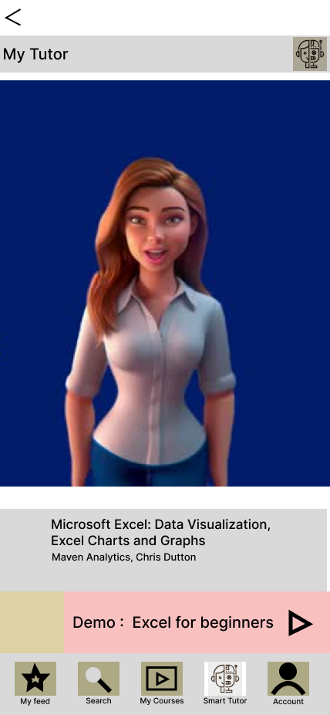
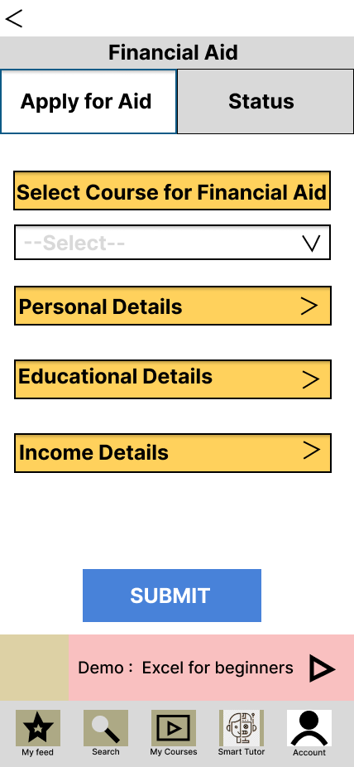
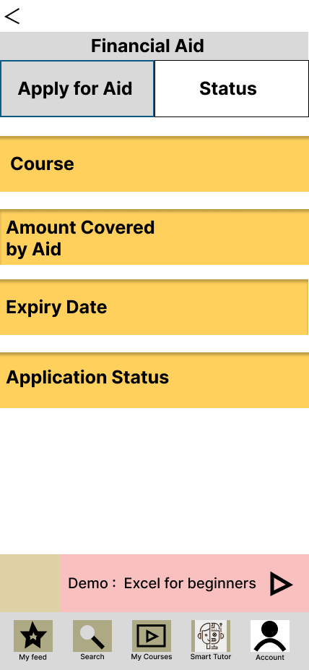
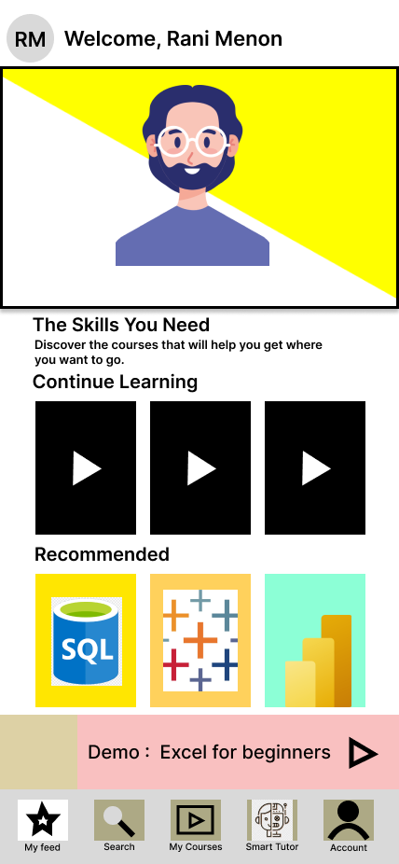
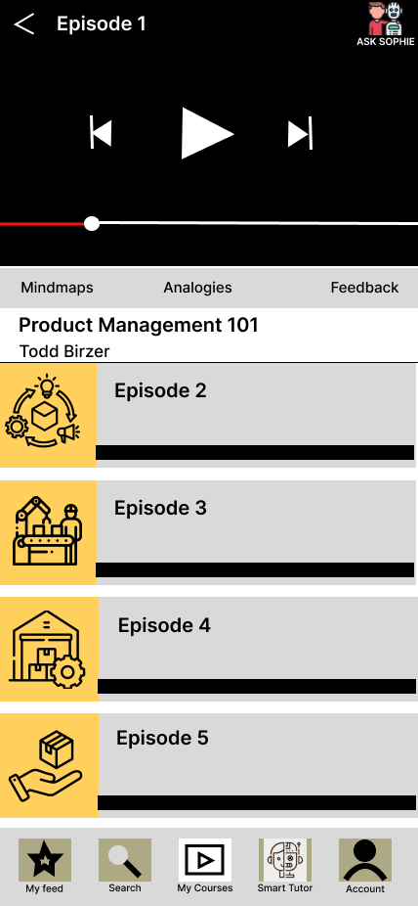
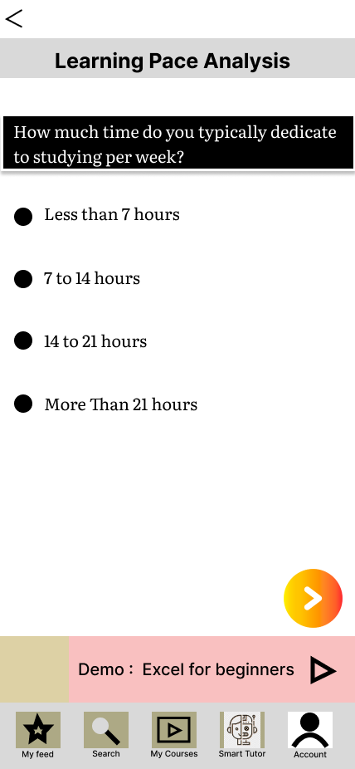
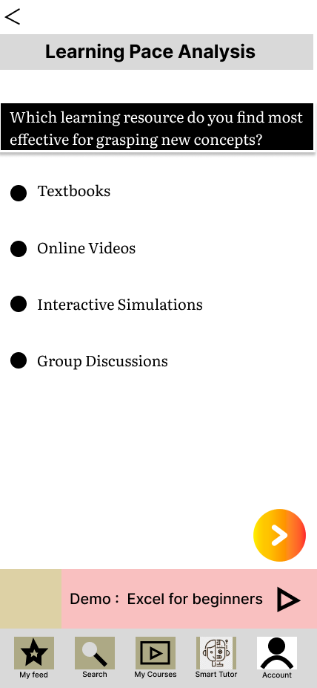
Architectural Diagram
From My Feed and Player screens, My Tutor screen is accessible
My Tutor is the generative AI of the EdNinja app with whom students can interact using audio
The language which is set in the settings section, Tutor will also respond in the same language
Students can ask doubts during the lecture related to the topic or even interact with the AI Tutor directly from the My Tutor section
Feedback questions related to student’s pace and interest are asked
Data from this is sent to the generative AI at the backend
Generative AI will use Regression technique to interpret student’s pace and suggest right content
Students can apply for Financial Aid for courses
Based on students’ SoP, educational and income details, credit score will be generated with the help of generative AI and aid will be provided
Status of the financial aid will be visible in the Status Block

Slide 9

Figma Prototype Link : https://shorturl.at/dguBZ

Slide 10
Building a better working world
Thank You

